Slide 1




MICROPROCESSOR
KCS 403
UNIT -I
TOPICS
Microprocessor evolution and types, microprocessor
architecture and operation of its components, addressing modes, interrupts, data transfer schemes, instruction and data flow, timer and timing diagram, interfacing devices
Jyoti Guglani
Department of Computer Science & Engineering
IMS ENGINEERING COLLEGE
Dr. A.P.J. Abdul Kalam Technical University,
Lucknow

Slide 2
MICROPROCESSOR
A Microprocessor is a multipurpose, programmable, register based, clock driven electronic device that takes the binary instructions from memory , take input from input device, process data according to instructions and provide output.

Slide 3
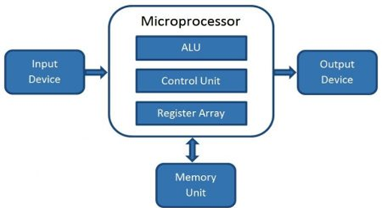

Slide 4
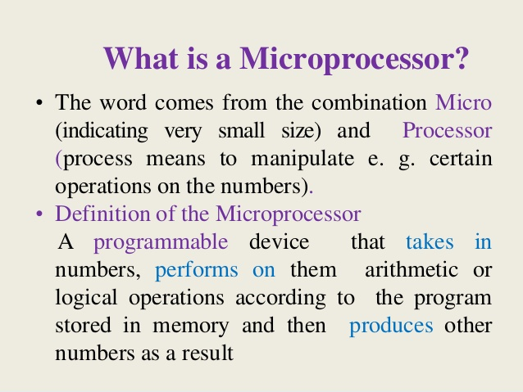

Slide 5
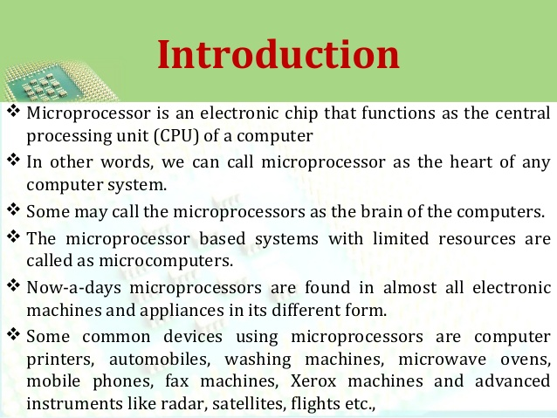

Slide 6
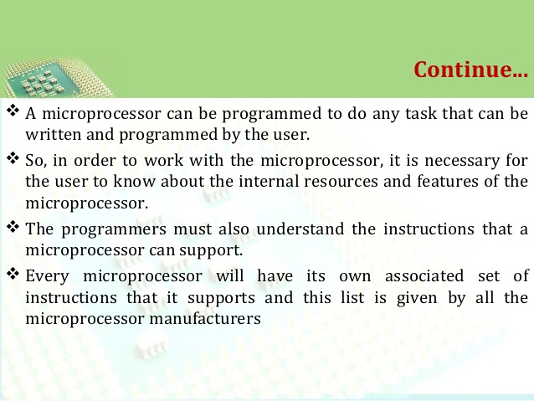

Slide 7
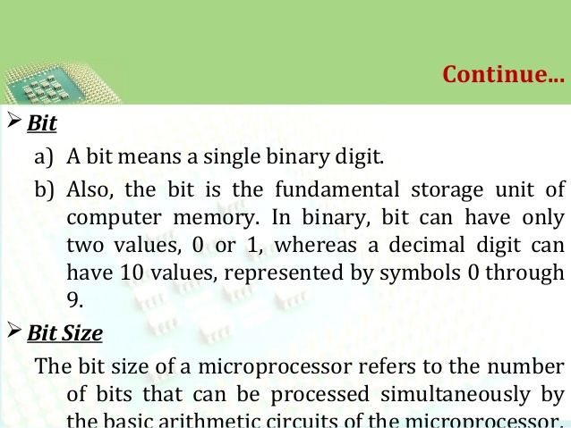

Slide 8
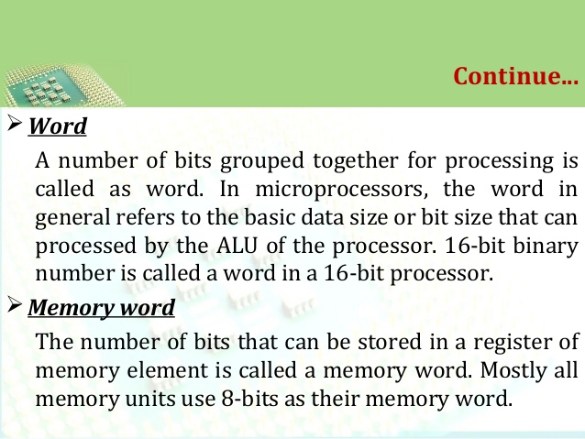

Slide 9
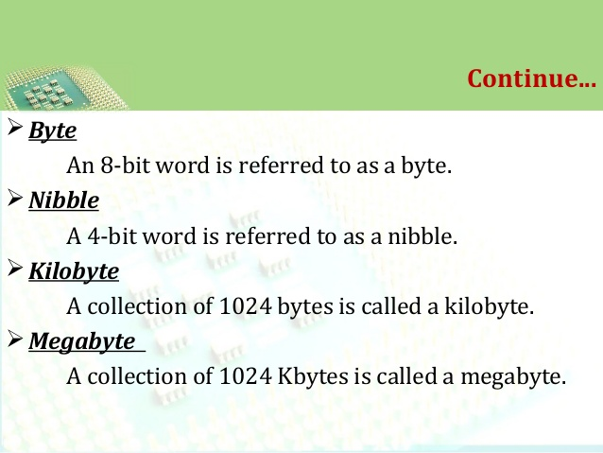

Slide 10
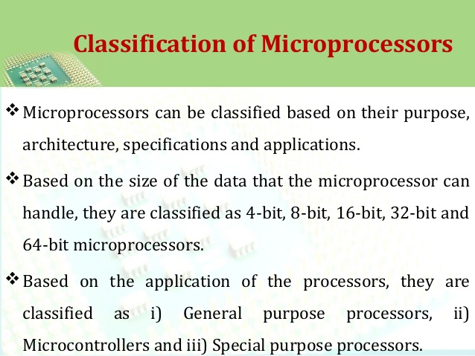

Slide 11
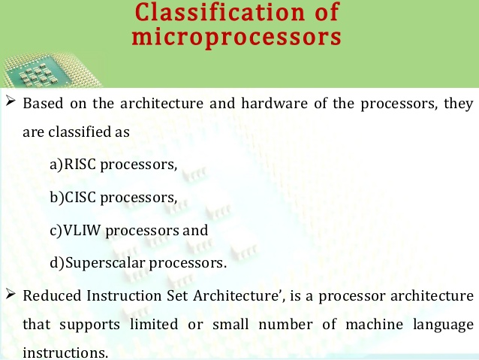

Slide 12
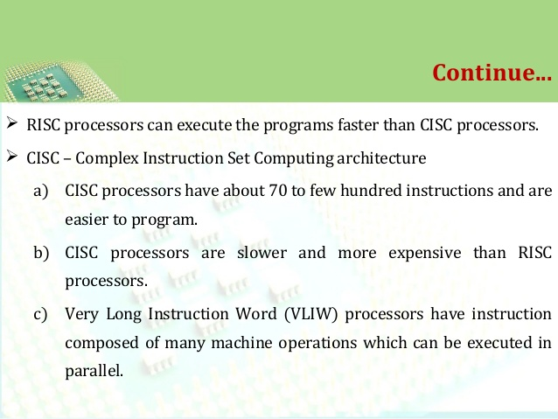

Slide 13
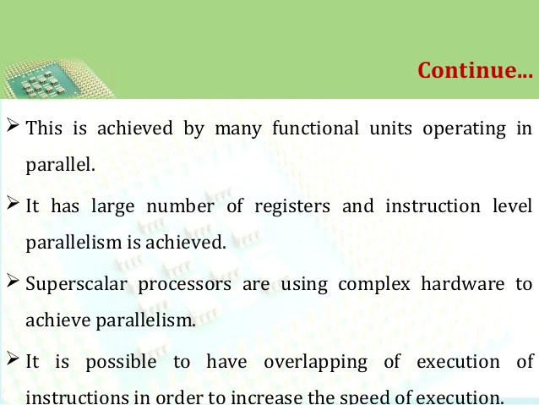

Slide 14
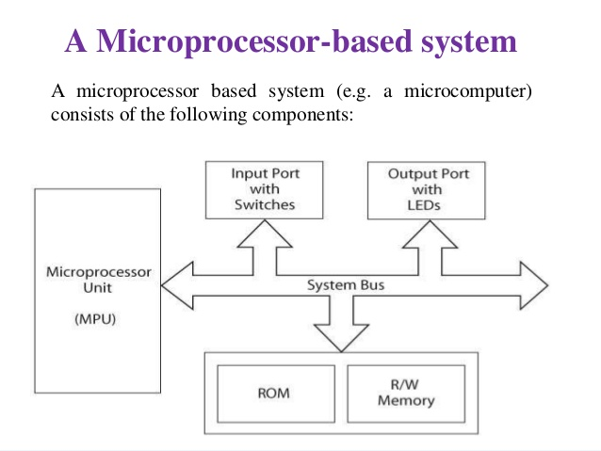

Slide 15
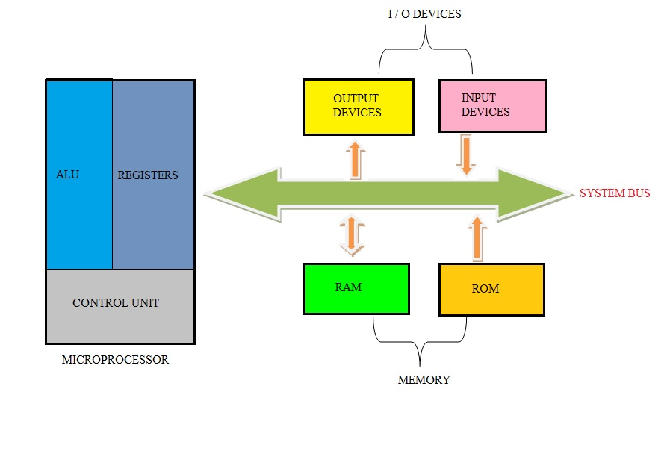

Slide 16
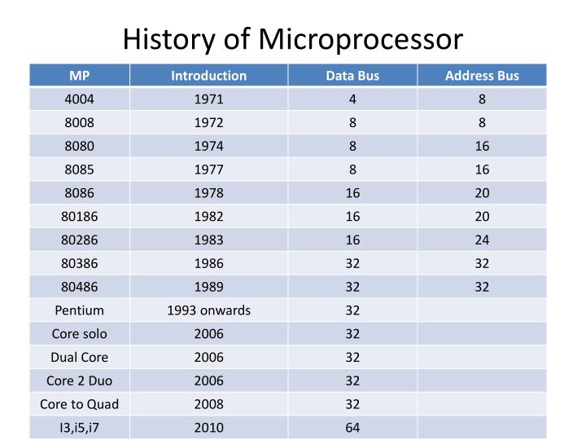

Slide 17
INSTRUCTION SET and TYPES of Instruction
An Instruction is a binary pattern designed inside a microprocessor to perform a specific function.
An Instruction Set is group of instructions support by microprocessor.

Slide 18
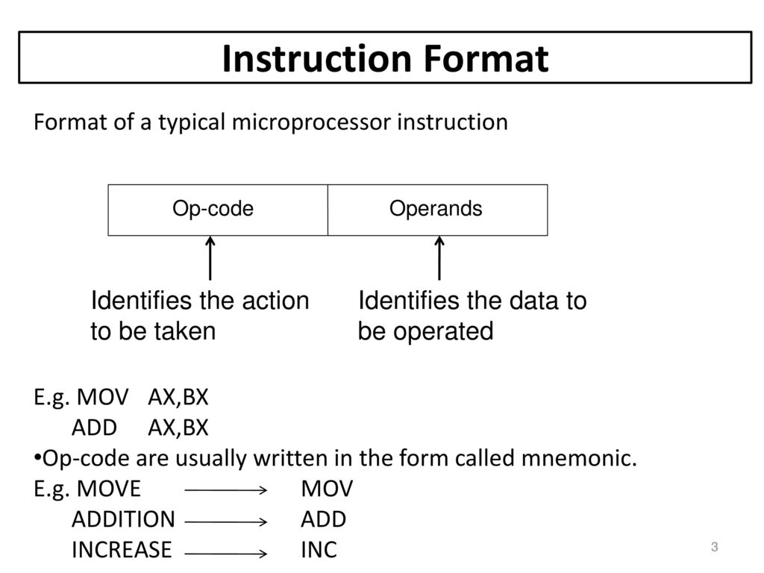
INSTRUCTION FORMAT

Slide 19
Types of instruction
Data transfer instruction
Data manipulation instruction
Program control instruction

Slide 20
Data transfer instruction
The data transfer instructions are used to transfer data from one location to another. This transfer of data can be either from register to register, register to memory or memory to register. It is important to note here that the memory to memory transfer of data directly is not possible.
Following are some instructions that are used for data transfer purpose:
MOV LOAD
PUSH XCHG
POP IN OUT
STORE

Slide 21
Data manipulation instruction
Data manipulation have arithmetic operations, logical operations and shift operations.
Arithmetic operations :-
ADD 5. INC
SUB 6. DEC
MUL 7. ADD With Carry
DIV 8. Subtract with borrow
Logical Operations:-
Compliment (COM) 4. Ex-OR 7. Set carry
CLEAR(CLR) 5. Clear Carry 8. Compliment carry
Logical AND 6. Logical OR

Slide 22
Data manipulation instruction
Shift operations:-
Logical Shift left
Logical shift right
Arithmetic shift left
Arithmetic shift right
Rotate left
Rotate right
Rotate left with carry
Rotate right with carry

Slide 23
Program Control Instructions
When MPU process the data from consecutive memory locations so each time one instruction is fetched from memory and the program counter is incremented.
It has two types of instructions:-
Unconditional
Conditional
Unconditional:- An unconditional branch instruction means control proceeds the next instruction in sequence.
Conditional:- A conditional branch instruction means control proceeds the next instruction when the condition met .

Slide 24
Program Control Instructions
JUMP
SKIP
BRANCH
CALL
RETURN
COMPARE

Slide 25
MICROPROCESSOR ARCHITECTURE
The microprocessor is a programmable logic device, designed with registers, flip-flops. The microprocessor has a set of instructions designed internally, to manipulate data and communicate with peripherals. This process of data manipulation and communication is determined by the logic design of the microprocessor, called the architecture.
The three main components of a microprocessor are ;
Arithmetic and Logic Unit : In this area of the microprocessor, computing functions are performed on data. The CPU performs arithmetic operations such as addition and subtraction, and logic operations such as AND, OR, and exclusive OR. Results are stored either in register or in memory or sent to output devices.
Register Unit : This area of the microprocessor consists of various registers. The register are used primarily to store data temporarily during the executing of a program. Some of the registers are accessible to the user through instructions.
Control Unit : The control unit provides the necessary timing and control signals to all the operations in the microcomputer. It controls the flow of data between the microprocessor and peripherals (including memory).
The microprocessor can be programmed to perform functions on given data by selecting necessary instructions from its set. These instructions are given to the microprocessor by writing them into its memory.

Slide 26
Microprocessor will perform functions:
1. Providing timing and control signals for all elements
2. Fetching instructions and data from memory
3. Decoding instructions
4. Transferring data to and from memory and I/O devices
5. Performing arithmetic and logic operations called for by instructions
6. Responding to I/O generated control signals such as RESET and INTERRUPT.
The MPU contains all of the logic circuitry for performing these functions.
Input: The input section transfers data and instructions in binary from the outside world to the microprocessor such as keyboards, teletypes, and analog-to-digital converters.
Output : The output section transfers data from the microprocessor to output devices such as light emitting diodes (LEDs), cathode-ray-tubes (CRTs), printers, magnetic tape, or another computer.
Memory : Memory stores binary information such as instructions and data, and provides that information to the microprocessor whenever necessary. To execute programs, the microprocessor reads instructions and data from memory and performs the computing operations in its ALU section. Result are either transferred to the output section for display or stored in memory for later use.

Slide 27
System Bus : The system bus is a communication path between the microprocessor and the peripherals; it is a group of wires that carries bits.
It is of three types;
Address Bus
Data Bus
Control Bus
Address bus will carry the address bits
Data bus will carry the data bits
Control bs will carry the control signals.
The microprocessor can be programmed to perform functions on given data by selecting necessary instructions from its set. These instructions are given to the microprocessor by writing them into its memory.
All the various functions performed by the microprocessor can be classified in three general categories :
Microprocessor-initiated operations
Internal data operations
Peripheral (or externally) initiated operations.

Slide 28
To perform these functions, the microprocessor requires a group of logic circuits and a set of signals called control signals. However, early processors do not have the necessary circuitry on one chip; the complete units are made up more than one chip. Therefore, the term Micro Processing Unit (MPU) is defined here as a group of devices that can perform these functions with the necessary set of control signals. This term is similar to the term Central Processing Unit (CPU).
However, later microprocessors include most of the necessary circuitry to perform these operations on a single chip. Therefore, the terms MPU and microprocessor often are used synonymously.
Microprocessor-Initiated Operations
The MPU performs primarily four operations.
Memory Read: Reads data from memory.
Memory Write: Writes data into memory.
3. I/O read: Accepts data from input devices.
4. I/O Write: Sends data to output devices.

Slide 29
All these operations are part of the communication process between the MPU and peripheral devices (including memory). To communicate with a peripheral (or a memory location), the MPU needs to perform the following steps:
Step 1 : Identify the peripheral or the memory location (with its address).
Step 2 : Transfer data
Step 3 : Provide timing or synchronization signals.
Internal Data Operations:
The internal architecture of microprocessor determines how and what operations can be performed with the data. These operations are
Store number of bits data.
2. Perform arithmetic and logical operations.
3. Test for conditions.
4. Sequence the execution of instructions.
5. Store data temporarily during execution in the defined R/W memory locations called the stack.
Peripheral (or externally) initiated operations:
These are the operations that are to be performed between microprocessor and peripheral devices i.e. input output devices.
Peripheral devices initiates the operations and microprocessor will perform that operations.

Slide 30
Types of Addressing Modes
The different ways in which the location of the operand is specified in an instruction are referred to as addressing modes
Immediate Addressing
Register Addressing
Direct Addressing
Register Indirect Addressing
Implied Addressing Mode

Slide 31
Immediate Addressing Mode- In immediate addressing mode the source operand is always data. If the data is 8-bit, then the instruction will be of 2 bytes, if the data is of 16-bit then the instruction will be of 3 bytes.
ADD 5 (Add content of register A with data 5)
MUL 4 (Multiply data of A register with 4)
Register Addressing Mode –
In register addressing mode, the data to be operated is available inside the register(s) and register(s) is(are) operands. Therefore the operation is performed within various registers of the microprocessor.
MOV A, B (move the contents of register B to register A)
ADD B (add contents of registers A and B and store the result in register A)
Direct Addressing Mode –
In direct addressing mode, the data to be operated is available inside a memory location and that memory location is directly specified as an operand. The operand is directly available in the instruction itself.
LDA 2050 (load the contents of memory location into accumulator A)

Slide 32
Register Indirect Addressing Mode –
In register indirect addressing mode, the data to be operated is available inside a memory location and that memory location is indirectly specified by a register pair.
Examples: MOV A, M (move the contents of the memory location pointed by the H-L pair to the accumulator)
Implied/Implicit Addressing Mode – In implied/implicit addressing mode the operand is hidden and the data to be operated is available in the instruction itself.
CMA (finds and stores the 1’s complement of the contains of accumulator A in A)
RRC (rotate accumulator A right by one bit)
RLC (rotate accumulator A left by one bit)
HALT (Terminate the program)

Slide 33
Interrupts
Interrupt is the mechanism by which modules like I/O or memory may interrupt the normal processing by MPU. It may be either clicking a mouse, dragging a cursor, printing a document etc the case where interrupt is getting generated.
Why we require Interrupt?
External devices are comparatively slower than MPU. So if there is no
interrupt MPU would waste a lot of time waiting for external devices
to match its speed with that of MPU. This decreases the efficiency of
MPU. Hence, interrupt is required to eliminate these limitations.
To perform the high priority task interrupt is introduced.

Slide 34
Advantages:
It increases the efficiency of MPU.
It decreases the waiting time of MPU.
Stops the wastage of instruction cycle.
Disadvantages:
MPU has to do a lot of work to handle interrupts,
resume its previous execution of programs

Slide 35
TYPES OF INTERRUPTS
Although interrupts have highest priority than other signals, there are many type of interrupts but basic type of interrupts are
1. Hardware Interrupts: If the signal for the processor is from external device or hardware is called hardware interrupts.
Hardware interrupts can be classified into two types:
Maskable Interrupt: The hardware interrupts which can be delayed when a much highest priority interrupt has occurred to the processor.
Non Maskable Interrupt: The hardware which cannot be delayed and should process by the processor immediately.
2. Software Interrupts: Software interrupt can also divided in to two types they are
Normal Interrupts: the interrupts which are caused by the software instructions are called software instructions.
Exception: unplanned interrupts while executing a program is called Exception. For example: while executing a program if we got a value which should be divided by zero is called a exception.

Slide 36
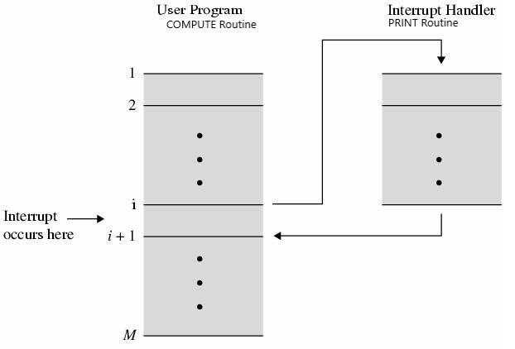
INTERRUPT SERVICE ROUTINE AND IT’S WORKING
The routine that gets executed when an interrupt request is made is called as interrupt service routine.
Step 1: When the interrupt occurs the processor is current executing i’th instruction and the program counter will be currently pointing to (i + 1)th instruction.
Step 2: When the interrupt occurs the program counter value is stored on the processes stack.
Step 3: The program counter is now loaded with the address of interrupt service routine.
Step 4: Once the interrupt service routine is completed the address on the processes stack is pop and place back in the program counter.
Step 5: Execution resumes from (i + 1)th line of COMPUTE routine

Slide 37
Data Transfer Schemes
The binary information that is received from an external device is usually stored in the memory unit. The information that is transferred from the MPU to the external device is originated from the memory unit. MPU merely processes the information but the source and target is always the memory unit. Data transfer between MPU and the I/O devices may be done in different modes.
1. Serial Data Transfer
Synchronous
Asynchronous
2. Parallel Data Transfer
Programmed I/O
Interrupt Initiated I/O
Direct Memory Access

Slide 38
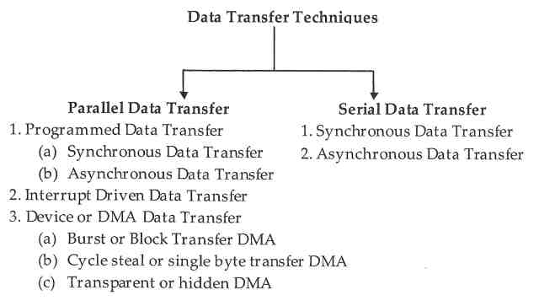

Slide 39
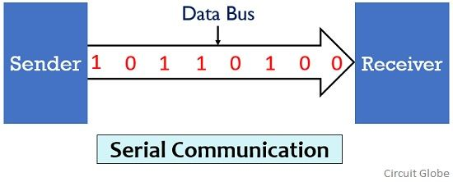
SERIAL DATA TRANSFER
In serial communication the data bits are transmitted serially over a common communication link one after the other. Basically it does not allow simultaneous transmission of data because only a single channel is utilized. Thereby allowing sequential transfer rather than simultaneous transfer. It is highly suitable for long distance signal transmission as only a single wire or bus is used. So, it can be connected between two points that are separated at a large distance with respect to each other. But as only a single data bit is transmitted per clock pulse thus the transmission of data is a quiet time taking process.

Slide 40
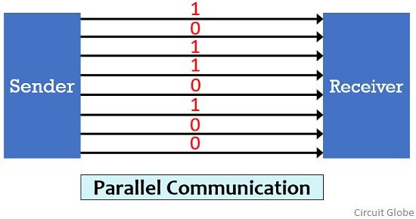
PARALLEL DATA TRANSFER
In parallel communication the various data bits are simultaneously transmitted using multiple communication links between sender and receiver. Here, despite using a single channel between sender and receiver, various links are used and each bit of data is transmitted separately over all the communication link. For connecting multiple lines between sender and receiver multiple connecting unit are to be present between a pair of sender and receiver. And this is the reason why parallel communication is not suitable for long distance transmission, because connecting multiple lines to large distances is very difficult and expensive.

Slide 41
SERIAL DATA TRANSFER TECHNIQUES | PARALLEL DATA TRANSFER TECHNIQUES
Under this scheme, the data is transferred one bit at a time. | Under this scheme, the data is transferred several bits at the same time.
It is a slower mode of data transfer. | Data is transferred much quicker.
Serial data transfer is preferred when data is to be sent over a long distance and the cost of cables would be too expensive. | Parallel data transfer is the preferred technique for short-distance communication.
For this mode, the transmitter first performs parallel – to – serial conversion and the serial – to – parallel conversion at the receiver. | No such conversions are required at both the transmission and reception endpoints.
This mode requires a single line to transfer information. | This mode requires multiple lines for data transfer.
Noise and errors are much lesser. | As multiple bits are transmitted at the same time, there is scope for more error and noise.
Cables used for serial communication are much thinner, longer, and very economical. | Here, the cables are much shorter, and thicker compared to the Serial communication cables.
This is a very reliable, inexpensive, and straightforward process. | It is considered a little unreliable, expensive, and complicated process.

Slide 42
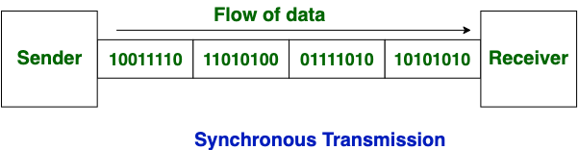
SYNCHRONOUS DATA TRANSFER
In Synchronous Transmission, data is sent in form of blocks or frames. This transmission is the full duplex type. Between sender and receiver the synchronization is compulsory. In Synchronous transmission, There is no gap present between data. It is more efficient and more reliable than asynchronous transmission to transfer the large amount of data.

Slide 43
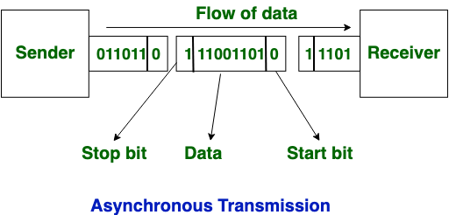
ASYNCHRONOUS DATA TRANSFER
In Asynchronous Transmission, data is sent in form of byte or character. This transmission is the half duplex type transmission. In this transmission start bits and stop bits are added with data. It does not require synchronization.

Slide 44
S.NO | Synchronous Transmission | Asynchronous Transmission
1. | In Synchronous transmission, Data is sent in form of blocks or frames. | In asynchronous transmission, Data is sent in form of byte or character.
2. | Synchronous transmission is fast. | Asynchronous transmission is slow.
3. | Synchronous transmission is costly. | Asynchronous transmission is economical.
4. | In Synchronous transmission, time interval of transmission is constant. | In asynchronous transmission, time interval of transmission is not constant, it is random.
5. | In Synchronous transmission, There is no gap present between data. | In asynchronous transmission, There is present gap between data.
6. | Efficient use of transmission line is done in synchronous transmission. | While in asynchronous transmission, transmission line remains empty during gap in character transmission.
7. | Synchronous transmission needs precisely synchronized clocks for the information of new bytes. | Asynchronous transmission have no need of synchronized clocks as parity bit is used in this transmission for information of new bytes

Slide 45
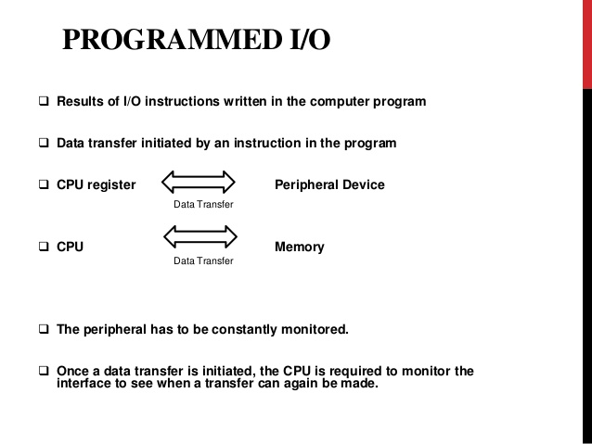

Slide 46
Processor requests I/O operation
I/O module performs operations.
I/O module sets status bits
Processor checks status bits periodically
I/O module does not inform Processor directly
I/O module does not interrupt CPU
Processor may wait or come back later
Under programmed I/O data transfer is very like memory access
Each device is given an unique identifier
Processor commands contain identifier (address)
Dis-advantage of Programmed I/O:
The problem with programmed I/O is that the processor has to wait a long time for the I/O module of concern to be ready for either reception or transmission of data.
The processor, while waiting, must repeatedly interrogate the status of the I/O module.
Performance of the entire system is severely degraded.

Slide 47
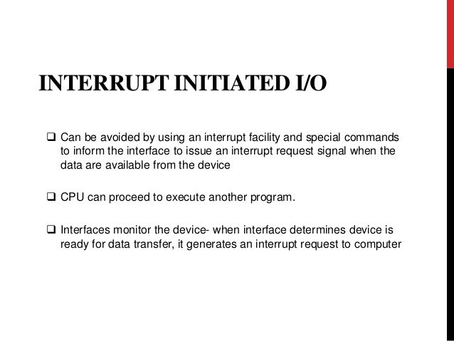

Slide 48
Interrupt Driven I/O Basic Operation:
Processor issues read command
I/O interface gets data from peripheral while MPU does other work
I/O interface interrupts MPU
Processor requests data
I/O interface transfers data
Working of Processor in terms of interrupts:
Issue read command.
Do other work.
Check for interrupt at end of each instruction cycle.
Multiple Interrupts:
Each interrupt line has a priority
Higher priority lines can interrupt lower priority lines

Slide 49
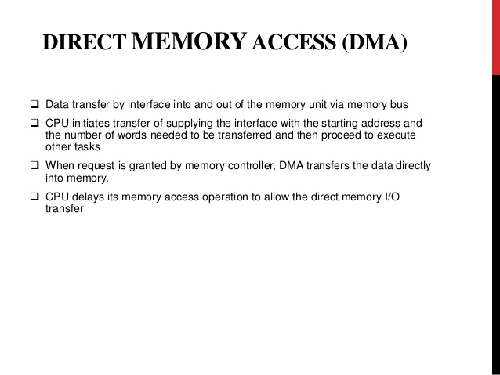

Slide 50
Direct Memory Access (DMA)
Interrupt driven and programmed I/O require active Processor intervention
Transfer rate is limited (processor to test and service the device)
MPU is tied up for managing I/O transfer.
DMA controller takes over from MPU
DMA module must use the bus only when the processor does not need it
It must force the processor to suspend operation temporarily. This technique is called cycle stealing.
DMA Operation:
MPU tells DMA controller:-
–Read/Write
–Device address
–Starting address of memory block for data
–Amount of data to be transferred
MPU carries on with other work
DMA controller deals with transfer
DMA controller sends interrupt when finished
Cyclic Stealing :
In this DMA controller transfers one word at a time after which it must return the control of the buses to the MPU. The MPU merely delays its operation for one memory cycle to allow the direct memory I/O transfer to “steal” one memory cycle.

Slide 51
As a MPU needs to communicate with the various memory and input-output devices (I/O) as we know data between the processor and these devices flow with the help of the system bus. There are two ways in which system bus can be allotted to them :
Have common bus (data and address) for I/O and memory but separate control lines.
Have common bus (data, address, and control) for I/O and memory.

Slide 52
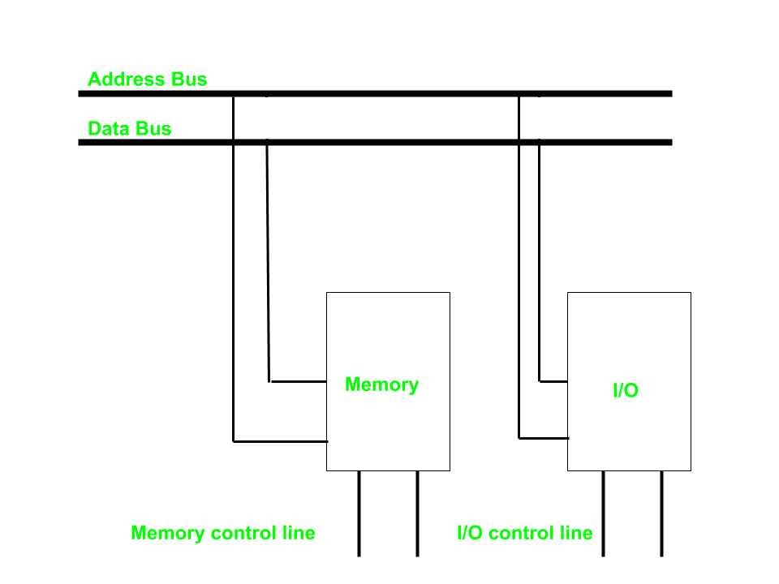
In first case it is simple because both have different set of address space and instruction but require more buses.
Isolated I/O –
Then we have Isolated I/O in which we Have common bus(data and address) for I/O and memory but separate read and write control lines for I/O. So when MPU decode instruction then if data is for I/O then it places the address on the address line and set I/O read or write control line on due to which data transfer occurs between CPU and I/O. As the address space of memory and I/O is isolated and the name is so. The address for I/O here is called ports. Here we have different read-write instruction for both I/O and memory.

Slide 53
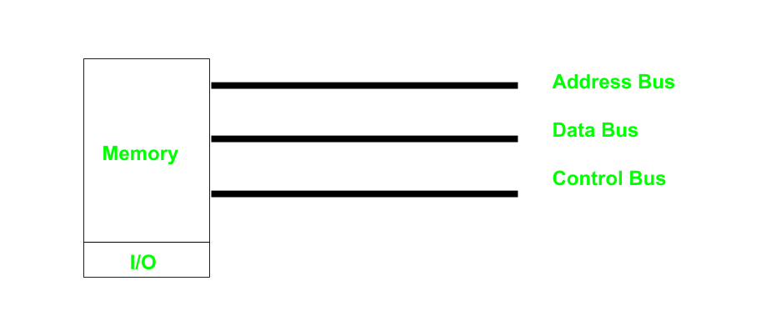
Memory Mapped I/O –
In this case every bus in common due to which the same set of instructions work for memory and I/O. Hence we manipulate I/O same as memory and both have same address space, due to which addressing capability of memory become less because some part is occupied by the I/O.

Slide 54
I/O Interface
Provides a method for transferring information between internal storage (such as memory and CPU registers) and external I/O devices.
They are special hardware components between CPU and peripheral to supervise and synchronize all input and output transfer.
They are called interface units because they interface between the processor bus processor bus and the peripheral device.
Resolves the differences between the computer and peripheral devices (1). Peripherals – Electromechanical or Electromagnetic Devices CPU or Memory - Electronic Device – Conversion of signal values required (2). Data Transfer Rate Peripherals - Usually slower CPU or Memory - Usually faster than peripherals – Some kinds of Synchronization mechanism may be needed (3). Data formats or Unit of Information Peripherals – Byte, Block, … CPU or Memory – Word (4). Operating modes of peripherals may differ must be controlled so that not to disturbed other peripherals connected to CPU
I/O Interface
Provides a method for transferring information between internal storage (such as memory and MPU registers) and external I/O devices.
They are special hardware components between MPU and peripheral to supervise and synchronize all input and output transfer.
They are called interface units because they interface between the processor bus processor bus and the peripheral device.
Resolves the differences between the computer and peripheral devices (1). Peripherals – Electromechanical or Electromagnetic Devices MPU or Memory - Electronic Device – Conversion of signal values required (2). Data Transfer Rate Peripherals - Usually slower MPU or Memory - Usually faster than peripherals – Some kinds of Synchronization mechanism may be needed (3). Data formats or Unit of Information Peripherals – Byte, Block, … MPU or Memory – Word (4). Operating modes of peripherals may differ must be controlled so that not to disturbed other peripherals connected to MPU

Slide 55
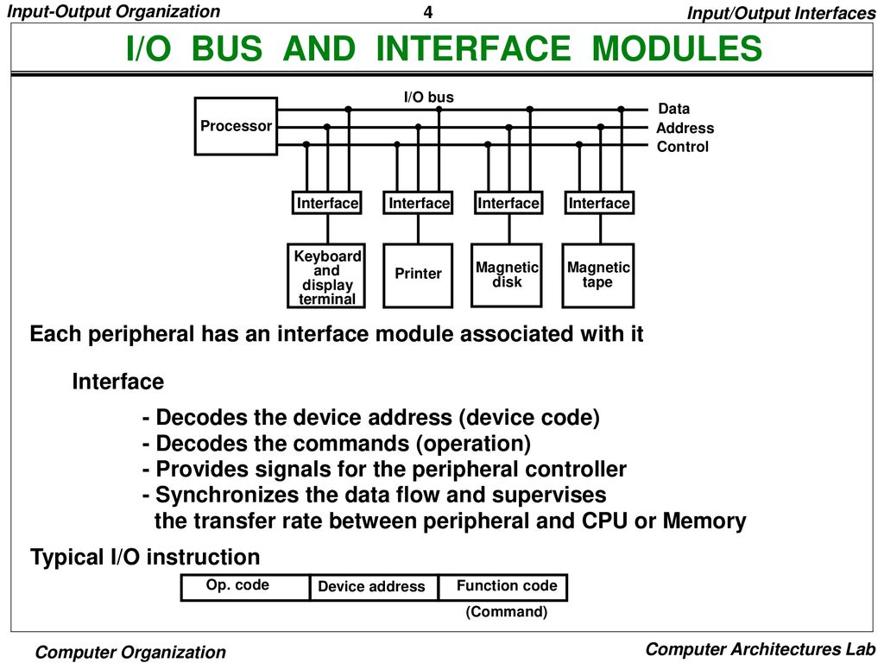
I/O Interface
Provides a method for transferring information between internal storage (such as memory and CPU registers) and external I/O devices.
They are special hardware components between CPU and peripheral to supervise and synchronize all input and output transfer.
They are called interface units because they interface between the processor bus processor bus and the peripheral device.
Resolves the differences between the computer and peripheral devices (1). Peripherals – Electromechanical or Electromagnetic Devices CPU or Memory - Electronic Device – Conversion of signal values required (2). Data Transfer Rate Peripherals - Usually slower CPU or Memory - Usually faster than peripherals – Some kinds of Synchronization mechanism may be needed (3). Data formats or Unit of Information Peripherals – Byte, Block, … CPU or Memory – Word (4). Operating modes of peripherals may differ must be controlled so that not to disturbed other peripherals connected to CPU

Slide 56
I/O Interface
Provides a method for transferring information between internal storage (such as memory and CPU registers) and external I/O devices.
They are special hardware components between CPU and peripheral to supervise and synchronize all input and output transfer.
They are called interface units because they interface between the processor bus processor bus and the peripheral device.
Resolves the differences between the computer and peripheral devices (1). Peripherals – Electromechanical or Electromagnetic Devices CPU or Memory - Electronic Device – Conversion of signal values required (2). Data Transfer Rate Peripherals - Usually slower CPU or Memory - Usually faster than peripherals – Some kinds of Synchronization mechanism may be needed (3). Data formats or Unit of Information Peripherals – Byte, Block, … CPU or Memory – Word (4). Operating modes of peripherals may differ must be controlled so that not to disturbed other peripherals connected to CPU
I/O Command is an instruction that is executed in the interface and its attached peripheral units. •Control command : is issued to activate peripheral and to inform what to do •Status command : used to test various status condition in the interface and the peripherals •Data o/p command : causes the interface to respond by transferring data from the bus into one of its registers •Data i/p command : interface receives an item of data from the peripheral and places it in its buffer register.

Slide 57
TIMING DIAGRAM
The timing diagram is the diagram which provides information about the various conditions of signals such as high/low, when a machine cycle is being executed. Without the knowledge of timing diagram it is not possible to match the peripheral devices to the microprocessors. These peripheral devices includes memories, ports etc. Such devices can only be matched with microprocessors with the help of timing diagram.

Slide 58
THANK YOU
STUDENTS
Take Care and Be Safe

